Slide 1
Arkady Volozh: A Visionary in Technology
Or the history of the founding of Yandex
Moscow, 2025
Prepared by: Sidorov D. S.

Slide 2
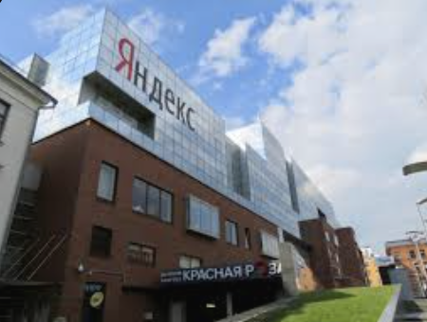
Introdution
Arkady Volozh is a famous tech entrepreneur from Kazakhstan. He co-founded Yandex, Russia's leading search engine, and guided its growth into a big tech company. Known for his innovative ideas, Volozh has played a key role in the digital world.
The Origins of Yandex
Yandex's story began in the 1990s when Arkady Volozh and Ilya Segalovich joined forces. Combining Volozh's entrepreneurial spirit and Segalovich's technical expertise, they created a search technology that could understand the Russian language better than existing platforms.

Slide 3
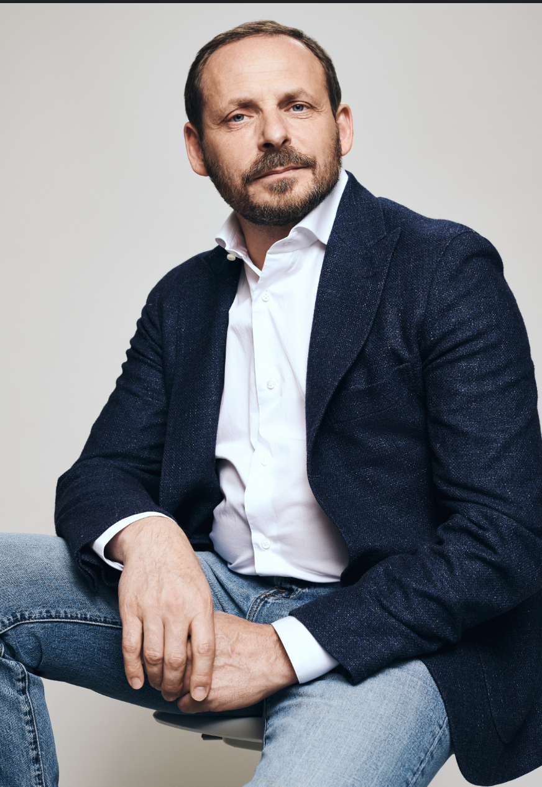
Establishing Yandex
In 1997, Yandex was officially launched as a standalone company. The name "Yandex" stands for "Yet Another iNDEXer." With Volozh as a co-founder, the company focused on building a robust search engine tailored to the Russian market.

Slide 4
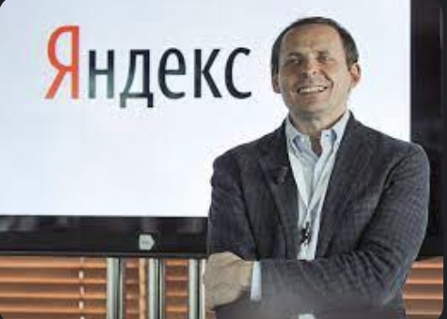
From Search to Success
Under Volozh's leadership, Yandex rapidly expanded. By the early 2000s, it dominated the Russian search market, pushing into new areas like maps, news, and shopping. Yandex's innovative services started to set it apart from global competitors.

Slide 5

Yandex on the Global Stage
In 2011, Yandex went public with an IPO on NASDAQ, marking a significant milestone. This move highlighted Yandex's status as a major player in the tech world and provided resources for further expansion into services like Yandex.Taxi and Yandex.Market.

Slide 6

Arkady Volozh's Legacy
Arkady Volozh stepped down from his CEO role in 2022, but his influence endures. Yandex remains a leader in tech innovation, shaping digital experiences across Russia and beyond. Volozh's vision continues to inspire the company's mission and growth.

Slide 7
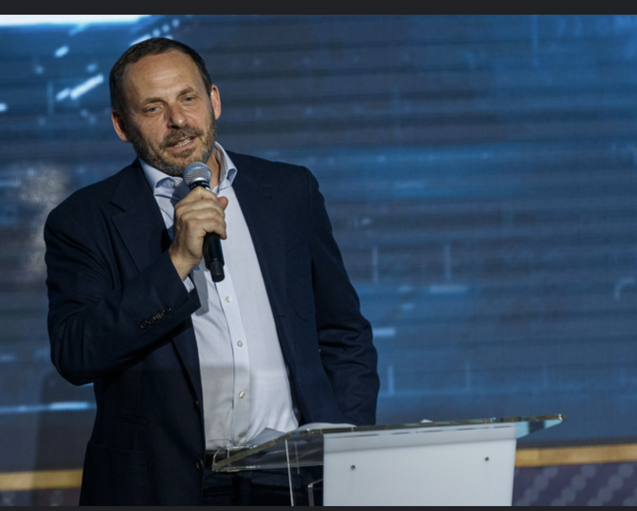
Conclusion
Arkady Volozh's vision and leadership have been instrumental in transforming Yandex from a small startup into a tech giant. His commitment to innovation and understanding of the Russian digital landscape allowed Yandex to thrive in a competitive global market. Volozh's journey serves as an inspiring example of how determination and creativity can lead to groundbreaking success. As Yandex continues to innovate and expand, the foundation laid by Volozh will remain a guiding force for the company's future endeavors.

Slide 8

Thanks for your attention
Prepared by: Sidorov D. S.

